Slide 1
Kyrgyz pastures:
COVID Made Us Think Deeper
Elvira Maratova
National pasture users’ association of Kyrgyzstan
June 10, 2020

Slide 2
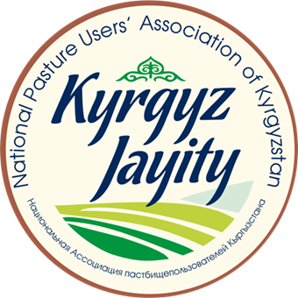
National pasture users’ Association of Kyrgyzstan “Kyrgyz Jayity”
is a voluntary association of legal entities and a non-profit organization dedicated to improving the ability of pasture users, Pasture User Unions and Pasture Committees to effectively manage and use pasture resources.
454 Pasture Users Unions
Kyrgyzstan
Central Asian country
Total area - 199,900 km2,
Population - 6.2 million people
65% live in rural areas
9 035 260 ha of natural pastures, the total area of which covers more than 85% of the total agricultural land area of Kyrgyzstan.
More than 93% of the area – mountains.

Slide 3
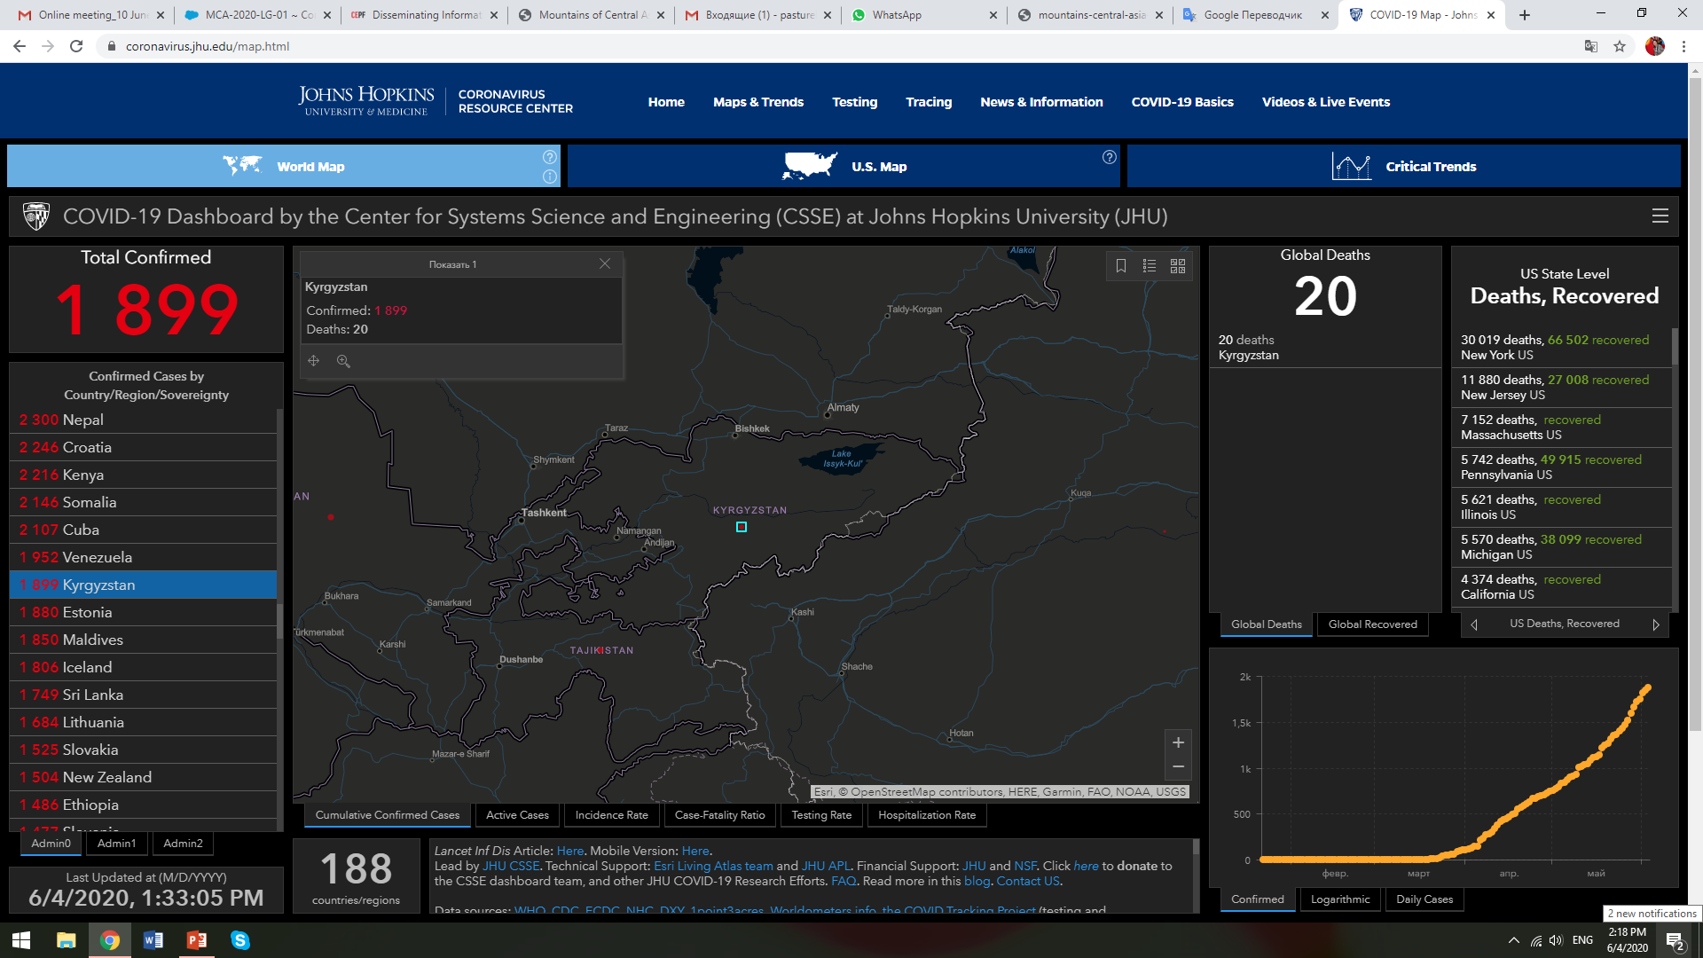
COVID-19 Kyrgyzstan
Confirmed cases
1899
Recovered
1292
Deaths
20
First confirmed case 18.03.20

Slide 4
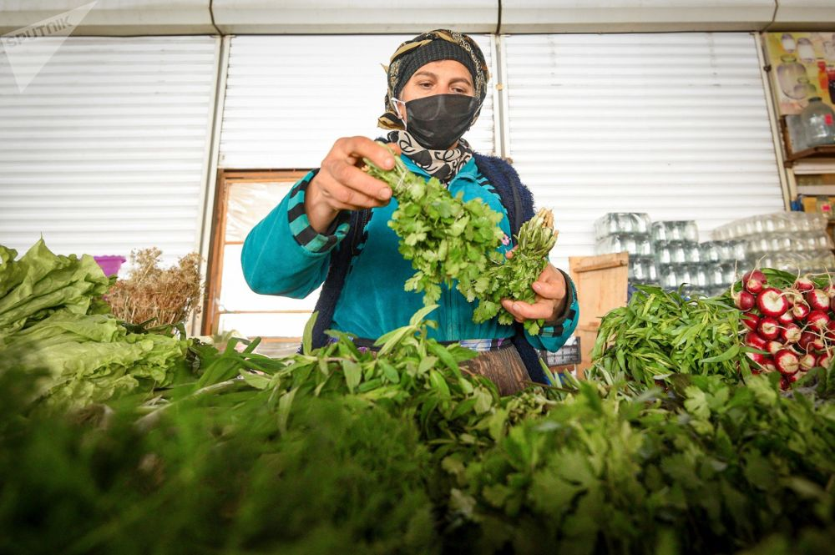
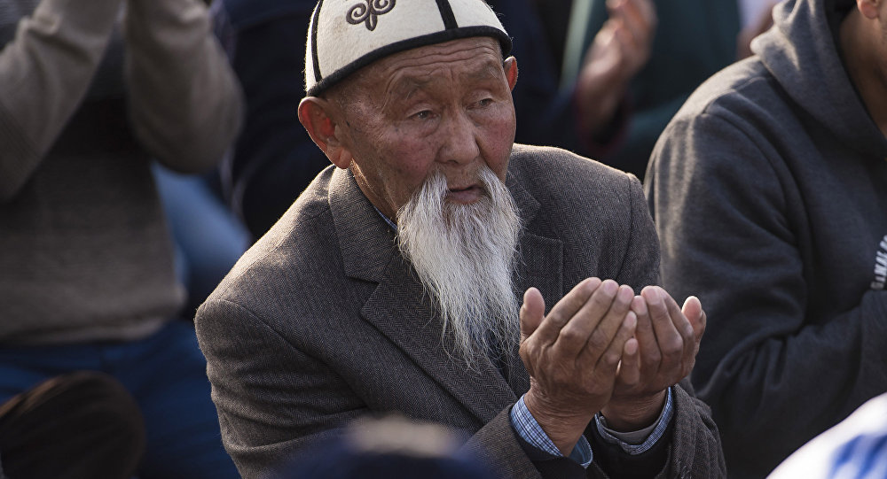
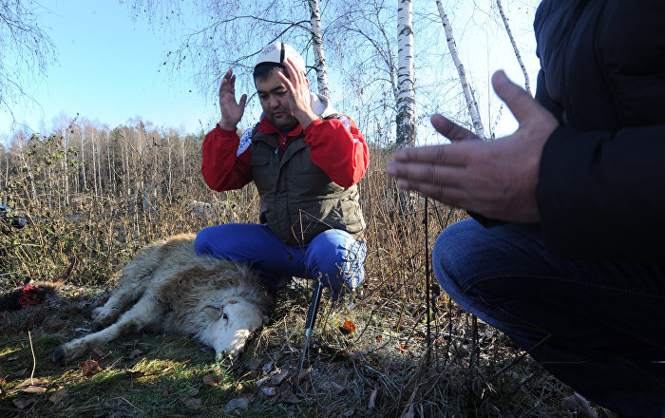
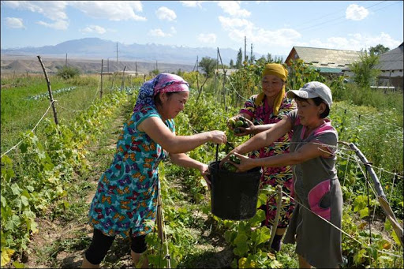
Reflections
procurement and marketing of milk, meat, etc.
transportation of agricultural products
closed bazaars, livestock markets
praying and animal sacrificing
new leaders, philanthropy
shortage of labour
blaming, denying

Slide 5
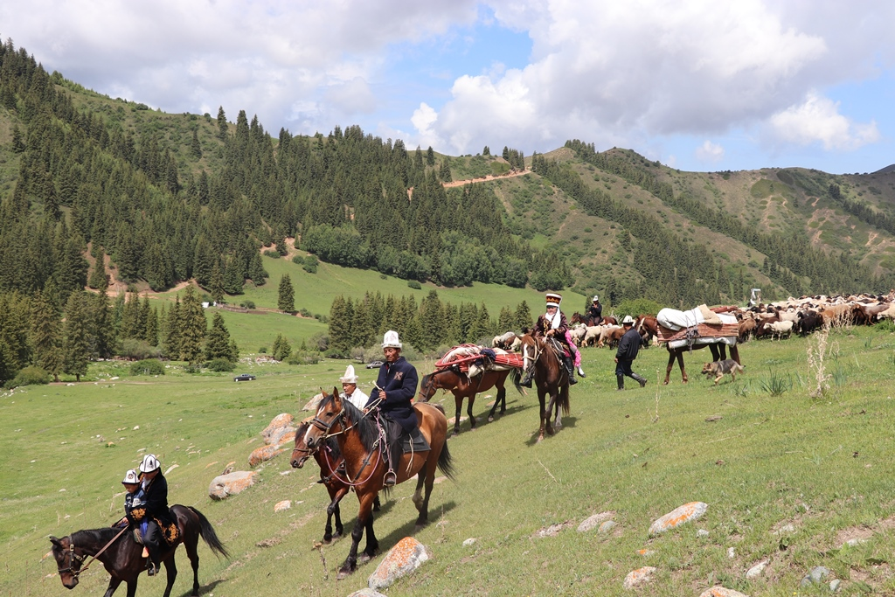
What can we do?
Pandemic control programs
Traditional knowledge
Public food purchasing
Development strategies
Experience sharing
Deep
analysis
Consultations with experts
Key Recommendations
1. Exempt pastoralism from the shutdown
2. Ensure access to grazing and enable migration
3. Ensure continued access to summer pastures
4. Resolving labour shortages
5. Provide adequate rations
6. Facilitate access to milk and meat markets
7. Issue COVID-free certificates to pastoralists
8. Provide veterinary support while on migration
Develop small farms
Awareness
raising

Slide 6
Stay home.
Stay safe.
www.jayit.kg
elvirmaratovaa@gmail.com
+996 555 061010

